Slide 1
PHASE 1 — MONITORING FOUNDATION
Building the visibility backbone of the SOC platform
Network · Host · Runtime · Infrastructure · SIEM

Slide 2
STEP 1 — DEFINING THE MONITORING FOUNDATION
PURPOSE
VISIBILITY LAYERS
Before any SOC logic can exist, the system must see what is happening. This phase defines the goal, layers to monitor, data types needed, and tools selected for full visibility.
Network — Detect suspicious traffic and attacks
KEY IDEA
Host / Endpoint — Detect suspicious activities on servers
The monitoring foundation must cover every critical layer of the system — from network traffic down to infrastructure health.
Runtime / Container — Detect abnormal execution behavior
Resource / Infrastructure — Detect overload and health issues
TOOLS SELECTED
Tool | Main Role
Suricata | Network IDS / network visibility
Wazuh | Host and endpoint security monitoring
Falco | Runtime and container security
Telegraf | Metrics and infrastructure health
Filebeat | Log collection and forwarding
Falcosidekick | Falco alert forwarding
Elasticsearch | Central storage, indexing, search
Kibana | Dashboards, monitoring, analysis
Collection — Gather and forward logs / alerts
Central Analysis — Store and search the data
Visualization — Make the data visible and usable
02

Slide 3
STEP 2 — GLOBAL ARCHITECTURE & DATA FLOW
SECURITY SOURCES
COLLECTION LAYER
SIEM CORE
System Logs
Suricata IDS
Filebeat
Elasticsearch
Auth Logs
Wazuh HIDS
Reads and ships logs
Falcosidekick
Central Storage, Search, Indexing
Falco Runtime
Receives Falco alerts
Kibana
Telegraf Metrics
Telegraf → ES (direct)
Dashboards, Monitoring, Analysis
GLOBAL LOGIC
Sources → Collection Layer → Elasticsearch → Kibana
System / auth logs → Filebeat | Suricata → eve.json → Filebeat | Wazuh alerts → Filebeat
Falco alerts → Falcosidekick | Telegraf metrics → Elasticsearch (direct)
Filebeat & Falcosidekick → Elasticsearch | Elasticsearch → Kibana
03

Slide 4
STEP 3 — DEPLOYMENT, TECHNICAL SETUP & REQUIREMENTS
SINGLE UBUNTU HOST
NATIVE / SYSTEM SERVICES
DOCKER SERVICES
Elasticsearch
Kibana
Filebeat
Falco
Falcosidekick
9200 HTTPS
5601 HTTPS
2801 HTTP
Suricata
Wazuh Manager
Telegraf
WHY THE SPLIT?
1514 / 1515 TCP
• SIEM core stays stable and centralized
• Runtime detection is isolated in containers
• Architecture stays simple and maintainable
HARDWARE REQUIREMENTS
Level | CPU | RAM | Disk
Minimum lab | 4 cores | 8 GB | 50 GB
Recommended | 8 cores | 16 GB | 100 GB
MAIN CONFIGURATION PATHS
Tool | Configuration Path
Elasticsearch | /etc/elasticsearch/*
Kibana | /etc/kibana/kibana.yml
Filebeat | /etc/filebeat/filebeat.yml
Suricata / Wazuh | /etc/suricata/* /var/ossec/*
04

Slide 5
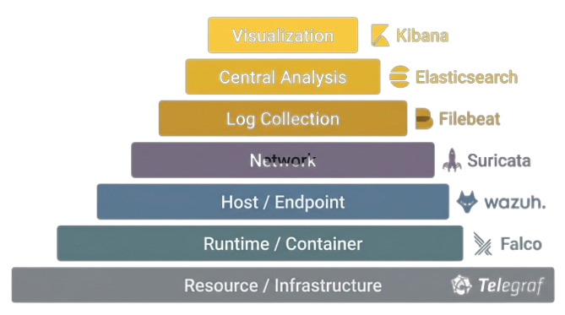
STEP 4 — VISIBILITY LAYERS, TOOL ROLES & FINAL OUTCOME
Visualization — Kibana — Dashboards, monitoring, analysis, exploration
Central Analysis — Elasticsearch — Storage, indexing, search, centralization
Log Collection — Filebeat + Falcosidekick — Shipping and forwarding logs / alerts
Network — Suricata — Traffic, suspicious packets, scans, protocol activity, IDS alerts
Host / Endpoint — Wazuh — Auth events, file integrity, suspicious host activity, agent alerts
Runtime / Container — Falco — Process behavior, syscalls, container activity, abnormal events
Resource / Infrastructure — Telegraf — CPU, RAM, disk, load, system health
Final Outcome: This layered architecture removes monitoring blind spots. Instead of watching only one part of the infrastructure, the system observes network, hosts, runtime, and resources — all centralized and visualized together. That is what gives the project global system visibility.
05

